Slide 1
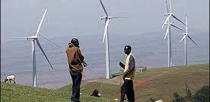







Kenya Carbon Emissions Reduction Tool 2050
Ministry of Energy

